Slide 1
Computer Graphics III – Monte Carlo integration Direct illumination
Jaroslav Křivánek, MFF UK
Jaroslav.Krivanek@mff.cuni.cz

Slide 2
Entire the lecture in 5 slides

Slide 3
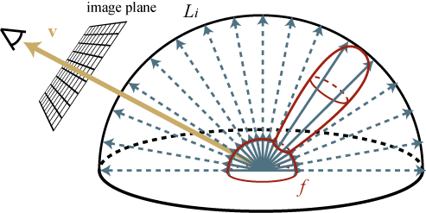
Reflection equation
upper hemisphere
over x
n
L_{i}(ω_{i})
L_{o}(ω_{o})
dω_{i}
θ_{o}
θ_{i}
L_{r}(ω_{o})

Slide 4
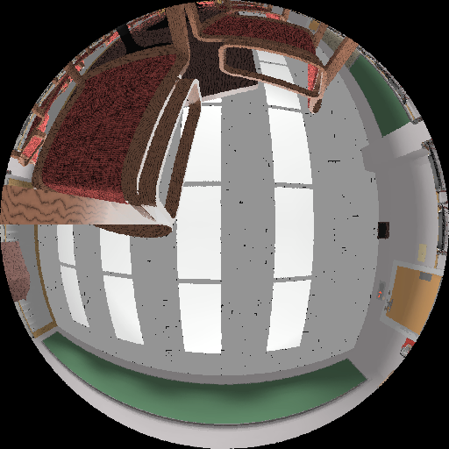
Rendering = Integration of functions
Problems
Discontinuous integrand (visibility)
Arbitrarily large integrand values (e.g. light distribution in caustics, BRDFs of glossy surfaces)
Complex geometry
Incoming radiance L_{i}(x,ω_{i}) for a point on the floor.
Images: Greg Ward

Slide 5
Monte Carlo integration
General tool for estimating definite integrals
Integral:
f(x)
Monte Carlo estimate I:
p(x)
0
ξ₅
ξ₃
ξ₁
ξ₄
ξ₂
ξ₆
1
Works “on average”:

Slide 6
Application of MC to reflection eq: Estimator of reflected radiance
Integral to be estimated:
PDF for cosine-proportional sampling:
MC estimator (formula to use in the renderer):
integrand(ω_{i})

Slide 7
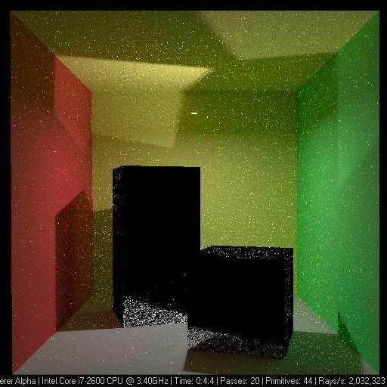
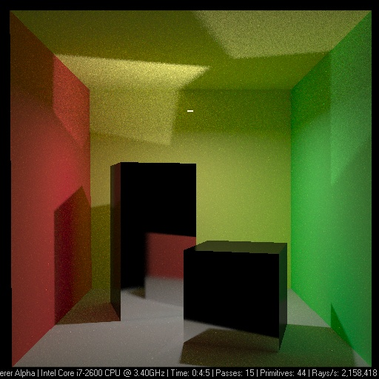
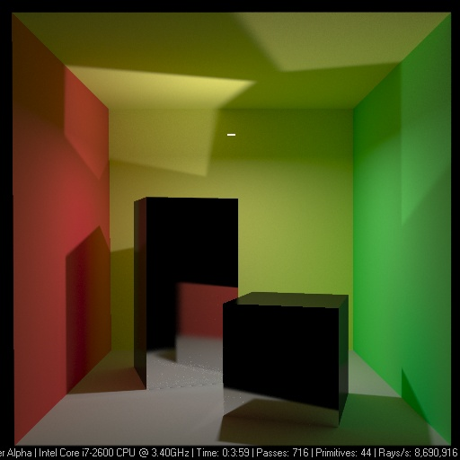
Variance => image noise

Slide 8
… and now the slow way

Slide 9
Digression: Numerical quadrature

Slide 10
Quadrature formulas for numerical integration
General formula in 1D:
f integrand (i.e. the integrated function) n quadrature order (i.e. number of integrand samples) x_{i} node points (i.e. positions of the samples) f(x_{i}) integrand values at node points w_{i} quadrature weights

Slide 11
Quadrature formulas for numerical integration
Quadrature rules differ by the choice of node point positions x_{i} and the weights w_{i}
E.g. rectangle rule, trapezoidal rule, Simpson’s method, Gauss quadrature, …
The samples (i.e. the node points) are placed deterministically

Slide 12
Quadrature formulas in multiple dimensions
General formula for quadrature of a function of multiple variables:
Convergence speed of approximation error E for an s-dimensional integral is E = O(N^{-1/s})
E.g. in order to cut the error in half for a 3-dimensional integral, we need 2³ = 8 – times more samples
Unusable in higher dimensions
Dimensional explosion

Slide 13
Quadrature formulas in multiple dimensions
Deterministic quadrature vs. Monte Carlo
In 1D deterministic better than Monte Carlo
In 2D roughly equivalent
From 3D, MC will always perform better
Remember, quadrature rules are NOT the Monte Carlo method

Slide 14
Monte Carlo

Slide 15
History of the Monte Carlo method
Atomic bomb development, Los Alamos 1940 John von Neumann, Stanislav Ulam, Nicholas Metropolis
Further development and practical applications from the early 50’s

Slide 16
Monte Carlo method
We simulate many random occurrences of the same type of events, e.g.:
Neutrons – emission, absorption, collisions with hydrogen nuclei
Behavior of computer networks, traffic simulation.
Sociological and economical models – demography, inflation, insurance, etc.

Slide 17
Monte Carlo – applications
Financial market simulations
Traffic flow simulations
Environmental sciences
Particle physics
Quantum field theory
Astrophysics
Molecular modeling
Semiconductor devices
Optimization problems
Light transport calculations
...

Slide 18
Slide credit: Iwan Kawrakov

Slide 19
Slide credit: Iwan Kawrakov

Slide 20
Variance => image noise

Slide 21
Monte Carlo integration
Samples are placed randomly (or pseudo-randomly)
Convergence of standard error: std. dev. = O(N^{-1/2})
Convergence speed independent of dimension
Faster than classic quadrature rules for 3 and more dimensions
Special methods for placing samples exist
Quasi-Monte Carlo
Faster asymptotic convergence than MC for “smooth” functions

Slide 22
Monte Carlo integration
Pros
Simple implementation
Robust solution for complex integrands and integration domains
Effective for high-dimensional integrals
Cons
Relatively slow convergence – halving the standard error requires four times as many samples
In rendering: images contain noise that disappears slowly

Slide 23
Review – Random variables

Slide 24
Random variable
X … random variable
X assumes different values with different probability
Given by the probability distribution D
X ∼ D

Slide 25
Discrete random variable
Probability mass function
Finite set of values of x_{i}
Each assumed with prob. p_{i}
Cumulative distribution function
Cumulative distribution func.

Slide 26
Continuous random variable
Probability density function, pdf, p(x)
In 1D:

Slide 27
Continuous random variable
Cumulative distribution function, cdf, P(x) V 1D:

Slide 28
Continuous random variable
Example: Uniform distribution
Probability density function (pdf)
Cumulative distribution function (cdf)

Slide 29
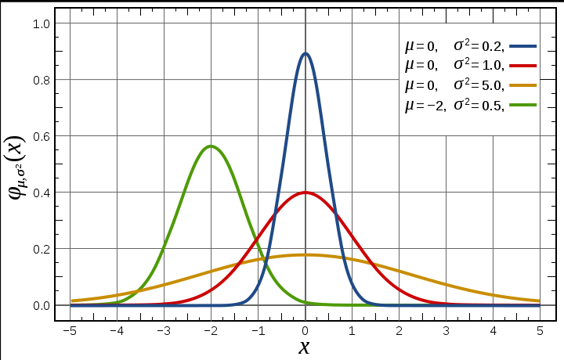
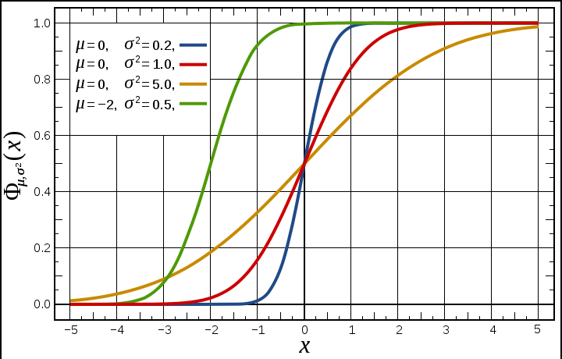
Continuous random variable
Gaussian (normal) distribution
Probability density function (pdf)
Image: wikipedia
Cumulative distribution function (cdf)

Slide 30
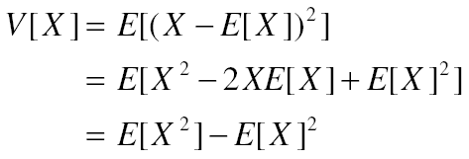
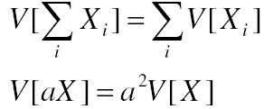
Expected value and variance
Expected value
Variance
Properties of variance
(if X_{i} are independent)

Slide 31
Transformation of a random variable
Y is a random variable
Expected value of Y
$$Y=g(X)$$
$$E[Y]=\int_{D}{g\left(x\right) p\left(x\right) dx}$$

Slide 32
Monte Carlo integration

Slide 33
Monte Carlo integration
General tool for estimating definite integrals
Integral:
f(x)
Monte Carlo estimate I:
p(x)
0
ξ₅
ξ₃
ξ₁
ξ₄
ξ₂
ξ₆
1
Works “on average”:

Slide 34
Primary estimator of an integral
Integral to be estimated:
Let X be a random variable from the distribution with the
pdf p(x), then the random variable F_{prim} given by the transformation f(X)/p(X) is called the primary estimator of the above integral.

Slide 35
Primary estimator of an integral
f(X)
f(x)
0
X
1

Slide 36
Estimator vs. estimate
Estimator is a random variable
It is defined though a transformation of another random variable
Estimate is a concrete realization (outcome) of the estimator
No need to worry: the above distinction is important for proving theorems but less important in practice

Slide 37
Unbiased estimator
A general statistical estimator is called unbiased if – “on average” – it yields the correct value of an estimated quantity Q (without systematic error).
More precisely:
Estimator of the quantity Q
(random variable)
Estimated quantity
(In our case, it is an integral,
but in general it could be anything. It is a number, not a random variable.)

Slide 38
Unbiased estimator
The primary estimator F_{prim} is an unbiased estimator of the integral I.
Proof:

Slide 39
Variance of the primary estimator
For an unbiased estimator, the error is due to variance:
(for an unbiased estimator)
If we use only a single sample, the variance is usually too high.
We need more samples in practice => secondary estimator.

Slide 40
Secondary estimator of an integral
Consider N independent random variables X_{i}
The estimator F_{N} given be the formula below is called the secondary estimator of I.
The secondary estimator is unbiased.

Slide 41
Variance of the secondary estimator
... standard deviation is √N-times smaller!
(i.e. error converges with 1/√N)

Slide 42
Properties of estimators

Slide 43
Unbiased estimator
A general statistical estimator is called unbiased if – “on average” – it yields the correct value of an estimated quantity Q (without systematic error).
More precisely:
Estimator of the quantity Q
(random variable)
Estimated quantity
(In our case, it is an integral,
but in general it could be anything. It is a number, not a random variable.)

Slide 44
Bias of a biased estimator
If then the estimator is “biased” (cz: vychýlený).
Bias is the systematic error of he estimator:

Slide 45
Consistency
Consider a secondary estimator with N samples:
Estimator F_{N} is consistent if i.e. if the error F_{N} – Q converges to zero with probability 1.

Slide 46
Consistency
Sufficient condition for consistency of an estimator:
Unbiasedness is not sufficient for consistency by itself (if the variance is infinite).
But if the variance of a primary estimator finite, then the corresponding secondary estimator is necessarily consistent.
bias

Slide 47
Rendering algorithms
Unbiased
Path tracing
Bidirectional path tracing
Metropolis light transport
Biased & Consistent
Progressive photon mapping
Biased & not consistent
Photon mapping
Irradiance / radiance caching

Slide 48
Mean Squared Error – MSE (cz: Střední kvadratická chyba)
Definition
Proposition
Proof

Slide 49
Mean Squared Error – MSE (cz: Střední kvadratická chyba)
If the estimator F is unbiased, then i.e. for an unbiased estimator, it is much easier to estimate the error, because it can be estimated directly from the samples Y_{i} = f(X_{i}) / p(X_{i}).
Unbiased estimator of variance

Slide 50
Root Mean Squared Error – RMSE

Slide 51
Efficiency of an estimator
Efficiency of an unbiased estimator is given by:
variance
Calculation time (i.e. operations count, such
as number of cast rays)

Slide 52
MC estimators for illumination calculation

Slide 53
Irradiance estimator – uniform sampling
Integral to be estimated:
PDF for uniform sampling:
Estimator:

Slide 54
Irradiance estimator – cosine-proportional sampling
Integral to be estimated:
PDF for cosine-proportional sampling:
Estimator

Slide 55
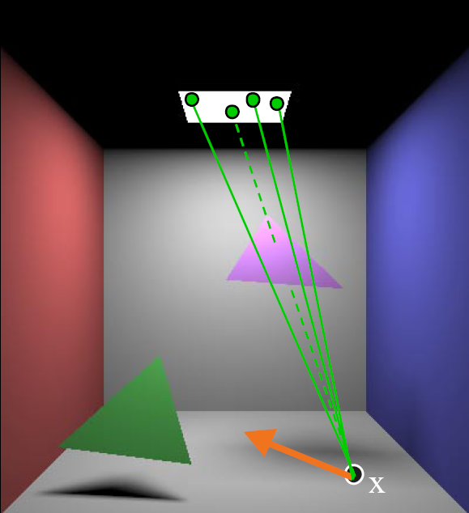
Irradiance estimate – light source sampling

Slide 56
Irradiance estimate – light source sampling
Reformulate the reflection integral (change of variables)
PDF for uniform sampling of the surface area:
Estimator

Slide 57
Light source vs. cosine sampling
Light source area sampling
Cosine-proportional sampling
Images: Pat Hanrahan

Slide 59
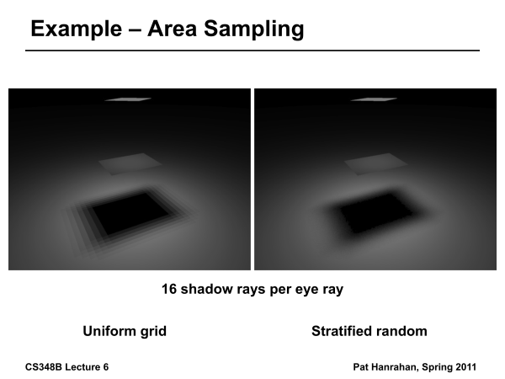

Slide 60
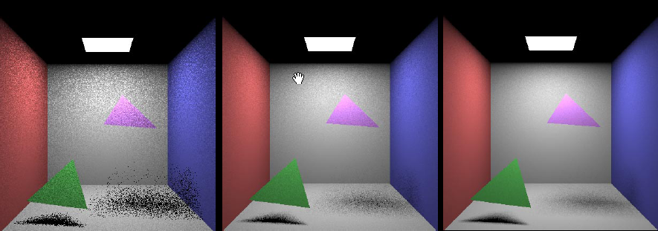
Area light sources
1 sample per pixel 9 samples per pixel 36 samples per pixel

Slide 61
Direct illumination on a surface with an arbitrary BRDF
Integral to be estimated
Estimator based on uniform light source sampling

